Slide 1

Banking: Spending / Saving / Bill Tracking (Smartphone)
CSCI5601 Designing for UX
Team Gold
Radhey Rupapara
Tejaswini rallapalli
Dharmay Sureja
Sagar vaghasia
Jayashree Ramasubramanian

Slide 2

Overview
Banking has become a part of everyone’s life and money management could be tedious be it from paying bills, analyse our spendings etc. Our research focusses on creating money management application and find shortcomings of existing applications that can help in analyse our spendings, bill tracking and savings.

Slide 3

What motivated us?!

Slide 4
Purpose and Motivation
When we physically record every purchase, we make or have to remember when to make monthly bill payments, managing our money may be a difficult chore.
Our study focuses on the many money management apps and how users can use them to manage their finances, get expenditure analyses, and keep track of their expenses.
This study also focuses on computing interest for loan instalments and sending users timely reminders to pay their payments.
Finding the need for using these applications and identifying the shortcomings of the already available money management applications on the market are the key goals of this study.
Instead of relying on the traditional method of remembering when a bill is due, we outlined a number of factors that consumers must consider when managing their finances in this study.

Slide 5

Initial Study
In the initial study, we have found the themes from the existing applications [1][2][3][4][5], compared various apps and found the features and tasks from those applications.
THEMES
APPLICATIONS
Managing and Tracking services
Voice-based system
User Interface
Report and Analysis
Money Manager Expense & Budget
YNAB (You Need A Budget)

Slide 6
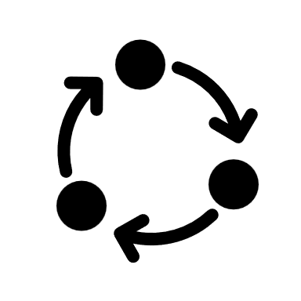
Contextual Inquiry
Location: The contextual inquiry process was done at Goldberg Computer Science building.
Process: Users were asked to do a variety of tasks using YNAB on a phone for us to better understand spending/saving/bill tracking. We conducted Pilot testing with 2 rounds of interview and Final testing with 3 rounds of interview with
The number of users were 3 and the researchers were 2 providing them with tasks and questions, and some end of study questions for about 40 minutes to find out their experiences of using the application.

Slide 7
Summary of Contextual Inquiry
We came up with 4 tasks for users to perform using the application “YNAB” and each had 4 Post-task questions
Set reminders for bill payments
Perform analysis on your expenditure
Use features on the application that will help you save money
Get an estimation on saving interest on the loan

Slide 8
Results of Contextual Inquiry
Tasks | Observations | Responses
Set reminders for bill payments | Some users found it confusing to set reminders due to intuitive interface | Able to set reminders for various categories
 |  | Use create category, edit category and set reminders options
 |  | Alerts with different colours to differentiate between categories
Perform expenditure analysis | Users found the interface to be easy but the icons on the navigation bar as intuitive | Use add category, edit category, delete category, create report and add expense to perform report generation
 |  | Analysis of expenditure was correctly shown
 |  | Users looked for guided tour and sub-category options in performing analysis
 |  | Able to give bar charts, pie charts and line graphs for the expenditure analysis
Use features on the app that will help to save money | Users found this task to be very easy and performed it correctly | Users used create budget, add category, add money to category and add bank account
 |  | Application showed the users the ways to save money
 |  | App provided alerts on how much are the spendings
 |  | For various sub-categories, it showed money saving options to users
Get an estimation on saving loan on interest | Users were able to perform the task easily due to familiarity of the app on the past usage basis | Application showed interest estimation based on the total loan amount
 |  | Edit budget and edit categories features helped in getting the correct estimate of interest
 |  | App showed the total amount of loan and what could be saved on interest

Slide 9
Contextual Inquiry Analysis
This chart was created based on the observations from contextual inquiry on how likely the users were or how easy the users found the app while performing the tasks. Here, the scale 1 being not likely to 5 being more likely (ignore 0 and 6)
Suggestions
Improve the report/analysis section by adding tooltips and buttons which helps users in easily performing the task.
Navigation in the app has to be improved with previous and next buttons.

Slide 10
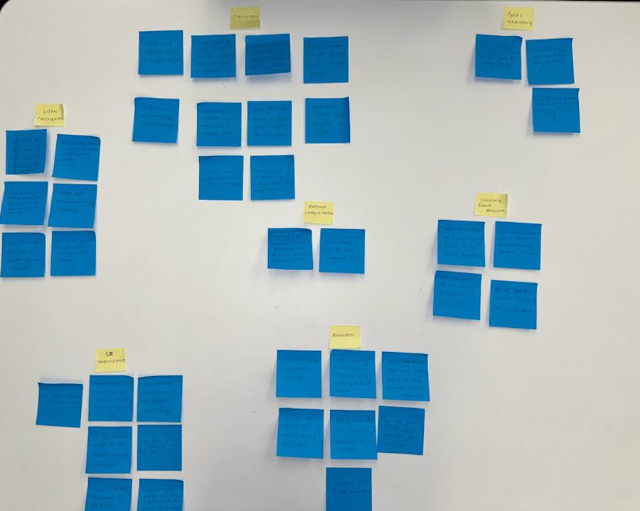
Analysis
For the analysis of contextual Inquiry that we performed, we did Affinity Diagramming that allowed us to identify potential tasks and features for our study.
Statistics
Loan Calculator
Reminders
Goal Tracking
Linking Bank Accounts
Expense Categorization
UI Improvements
Identified Features

Slide 11

Analysis and Evaluation (Cont’d)
Problems Identified
Difficult navigating to the categories section
Missing instruction on how to set reminders
Missing icons/options to edit the details
Cluttered with many transactions for report analysis
Too many clicks to perform a single task
Suggestions/Improvements:
Provide an edit option or the previous button for users to edit the details
Reduce number of clicks need to perform a task
Provide clear navigation to categories and other features in the app
Provide tooltips wherever necessary for the user

Slide 12
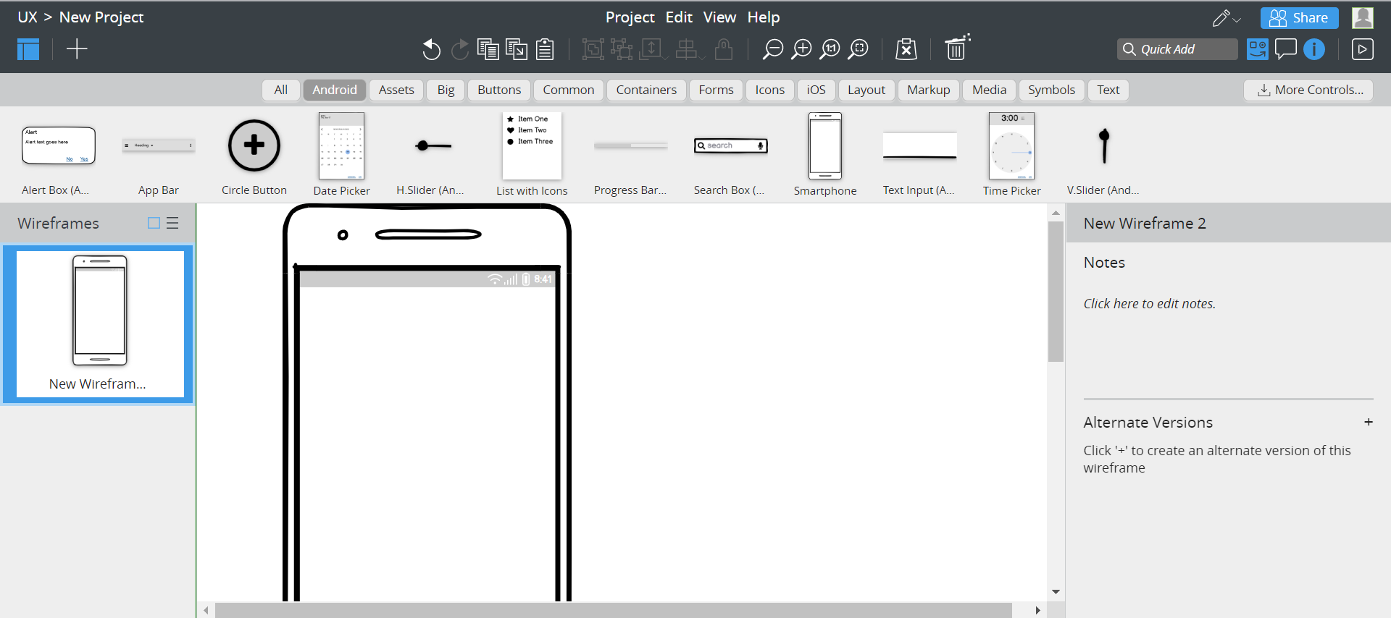
Creating Prototypes
Based on the suggestions and improvements, we have created Low-fidelity prototypes using the Balasmiq [6] tool throughout the study which allowed us to create prototypes easily with the drag-and-drop options.

Slide 13
Prototypes
Features | Task
Reminders | Setting reminder for custom time interval
Visualization | Analyzing the data of expenditure using graphs
Loan Calculator | Prediction for early loan payoff for interest saving

Slide 14
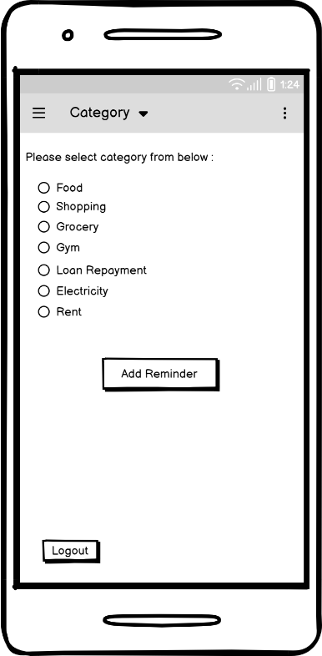
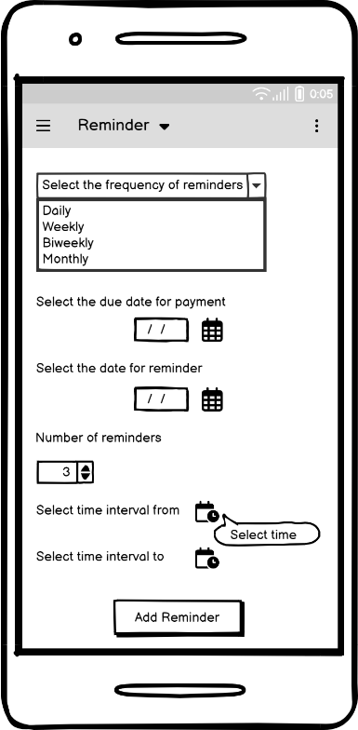
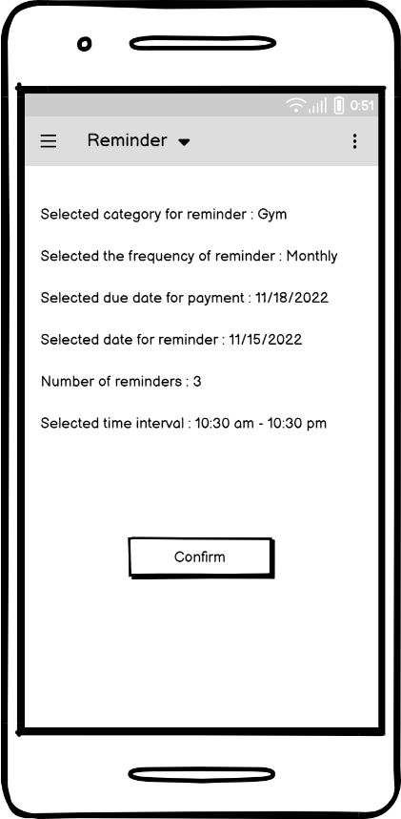
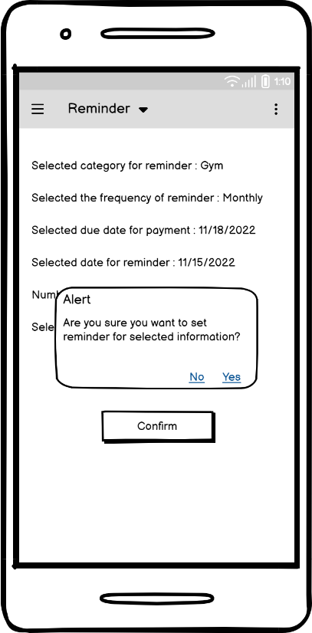
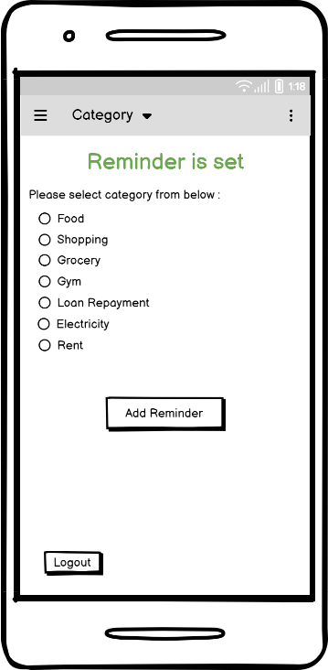
Task 1: Setting reminder for custom time interval

Slide 15
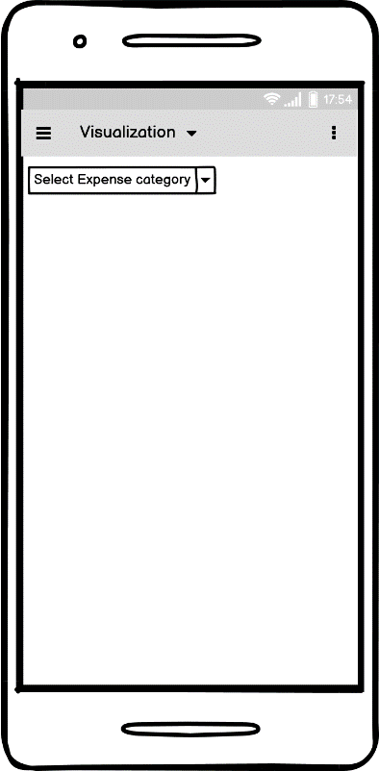
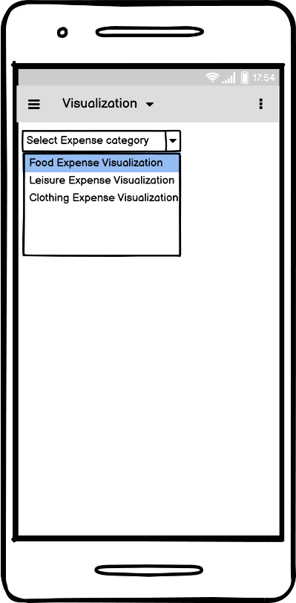
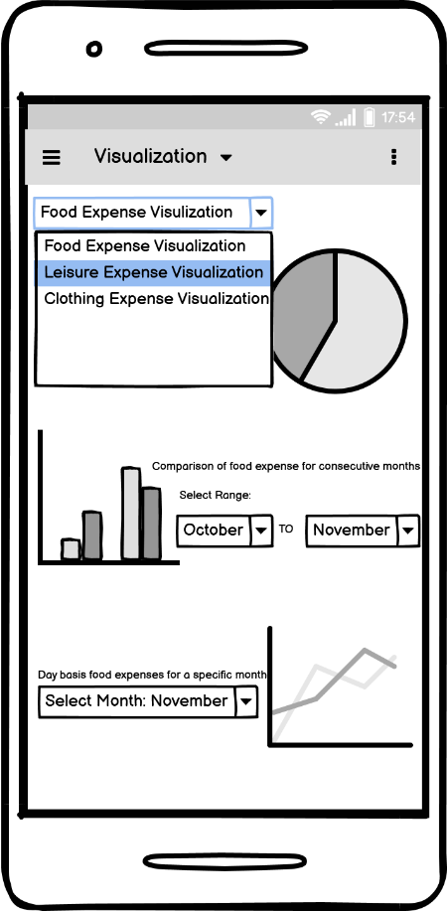
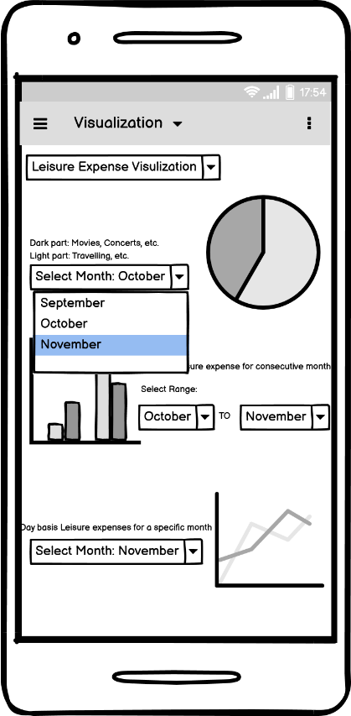
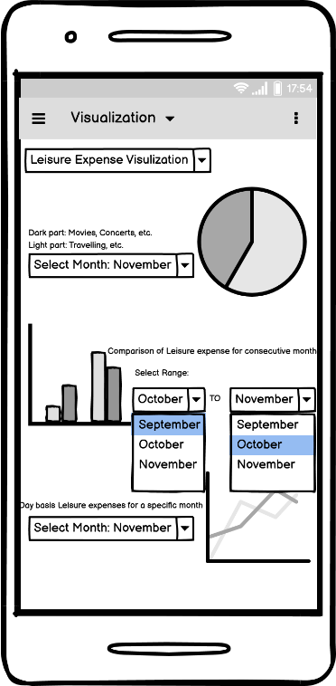
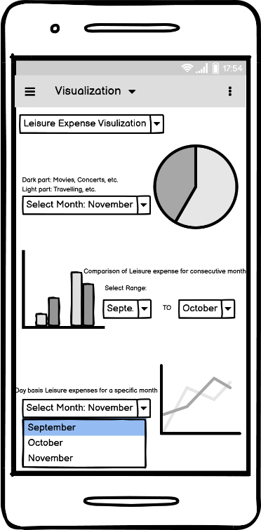
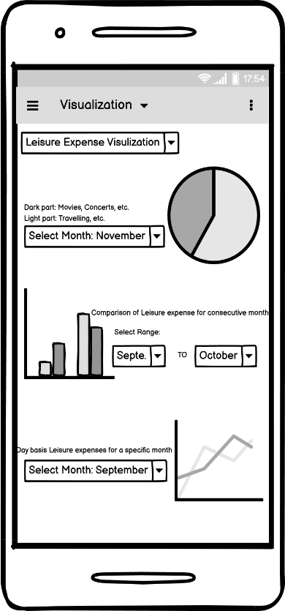
Task 2: Analyzing the data of expenditure using graphs

Slide 16
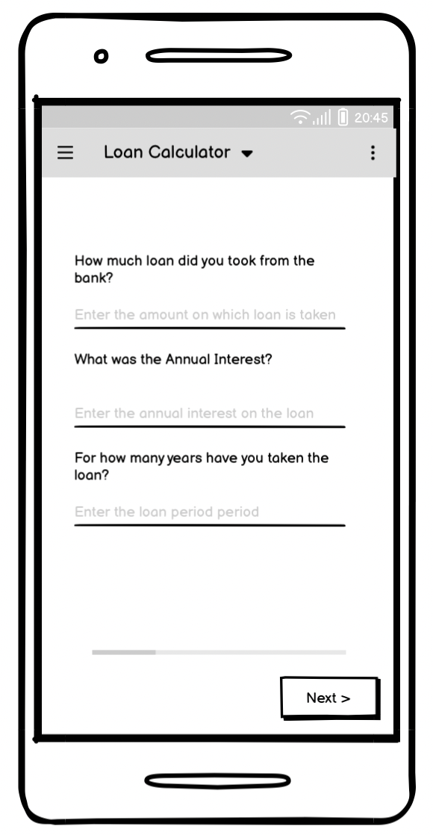
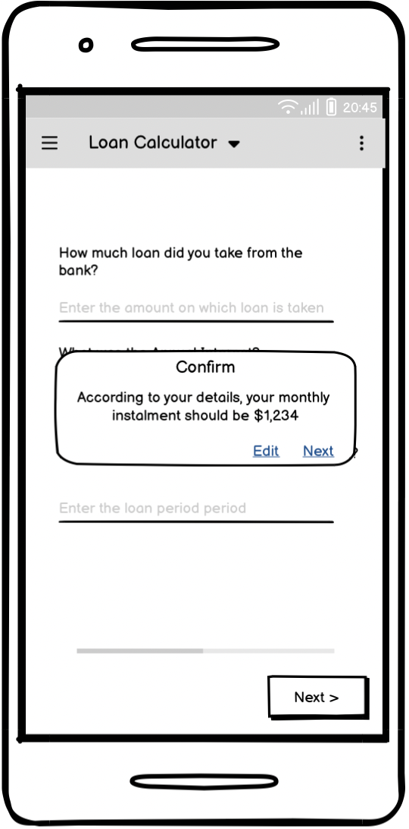
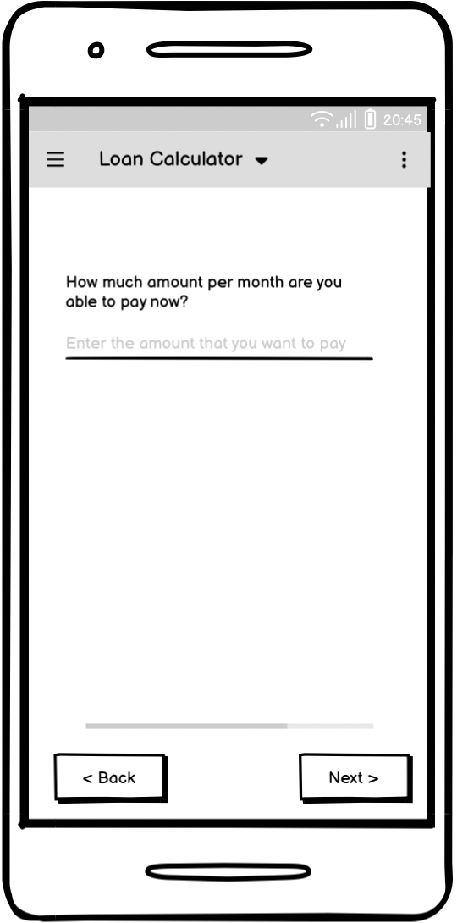
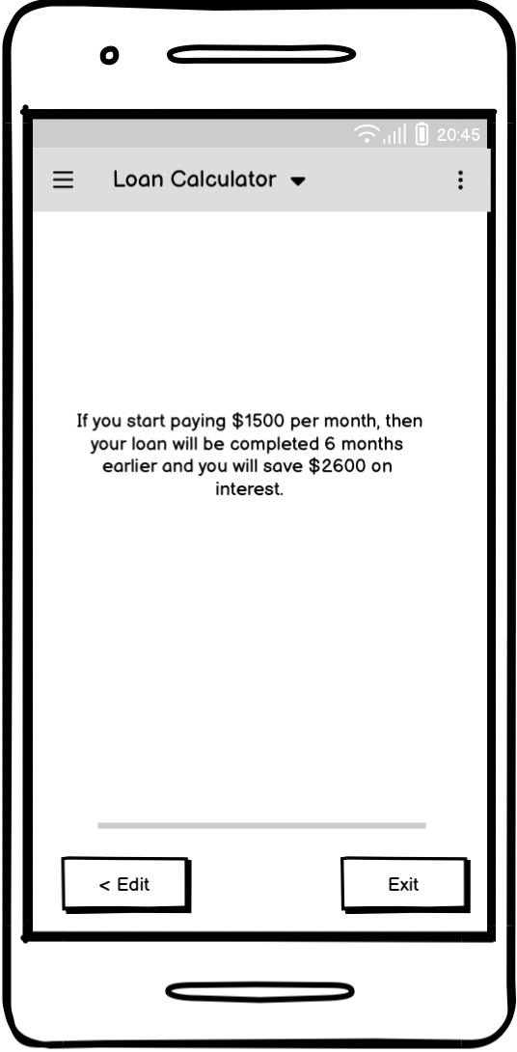
Task 3: Prediction for early loan payoff for interest saving

Slide 17
Summary of Cognitive Walkthrough
After working on appendices and interviewing, proposed and applied corrections to some existing and new features of the application
Researched how Abby (user person) will interact and how her motivations and knowledge will affect the usage
Designed Prototypes to be evaluated in two rounds of Walkthroughs
Created tasks for evaluators with normal use cases to perform with a task scenario
Evaluators filled CW sheets with “yes”, “no” and “maybe” to justify the probability of usability for Abby
Evaluators were asked to find errors that need to be addressed to improve User Experience and note the severity (1 is lowest and 5 is highest, MF is must Fix) of the issue

Slide 18
Task | Evaluators | Severity | Observation
Set Reminder for custom time interval | 2,3,4,5 | 2 | The add reminder button which is misguiding as it is not adding reminder but taking to next page.
 | 2,3,5 | 1-3 | There is no option of start and end date of reminder, add reminder button takes to the confirmation page which is misguiding.
 | All | MF | The back button is missing.
 | All | MF | No need to confirm the second time.
Analyzing the data of expenditure using graphs | 1,2,3,5 | MF | What to do after selecting the dropdown is unclear.
 | 4 | MF | A button is required that takes to the next step.
 | 5 | 3 | Some instruction would help would be good to guide to change the month.
 | 4 | 3 | All the graphs at same time is bit confusing.
Prediction for early loan payoff for interest saving | 1,4,5 | 2-3 | Less information about what will happen in next step which misleads to false interpretation about next steps.
 | All | MF | The Exit button interprets that application would be closed, must be replaced with Home
Results of Cognitive Walkthrough

Slide 19
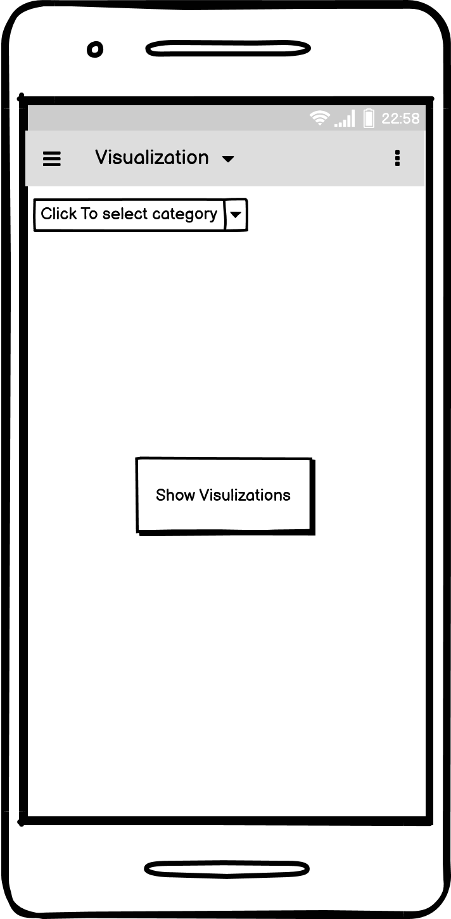
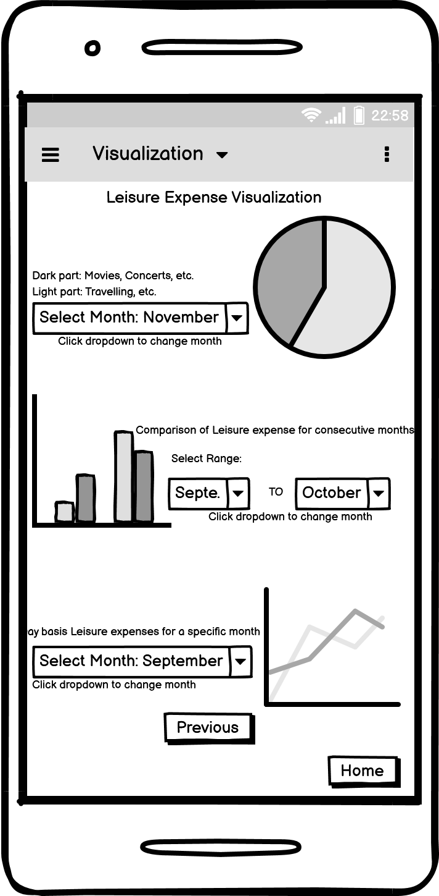
Updated Prototypes
Task 2: Analyzing the data of expenditure using graphs
Updated Title of the category selection Drop down menu
Added Show Visualization button
Added heading to show selected Category
Added description to month selection dropdown
Added Previous and Home buttons to go back and change category

Slide 20
General findings
The labelling has to be done properly so that the end user knows what action they need to perform to complete the task
When the information is represented graphically or through pictures, it becomes easier for the end user to understand, rather than mere text information
Application should have a clear and consistent layout
We need to focus on the user needs and design the application, in such a way that users can understand and find it easy to navigate and use the application
We should only provide the information that is necessary to the end-user and not burden them by providing more information, which can confuse them
The application has to be functional, and need not be fanciful
Should follow the UI design patterns like getting feedback from the team and end users, using standard user interface controls, elements etc.

Slide 21
Conclusion and Future Work
We are planning on creating High-fidelity prototypes for the existing application.
Add more intuitive ways to navigate within the app.
Create more visualizations to analyse the expenditures.
The application can be integrated with multiple payment methods and the users should be able to pay bills through the app.
Users should be able to create teams like ‘SpiltWise’ app and should be able to share the expense within the team.

Slide 22
References
[1] Sumit Pandey. 2013. Responsive design for transaction banking - a responsible approach. In Proceedings of the 11th Asia Pacific Conference on Computer Human Interaction (APCHI '13). Association for Computing Machinery, New York, NY, USA, 291–295. https://doi.org/10.1145/2525194.2525271
[2] Udayan Tandon, Lavanya Siri, Apurv Mehra, and Jacki O'Neill. 2019. Designing a financial management smartphone app for users with mixed literacies. In Proceedings of the Tenth International Conference on Information and Communication Technologies and Development (ICTD '19). Association for Computing Machinery, New York, NY, USA, Article 35, 1–5. https://doi.org/10.1145/3287098.3287131
[3] Samia Ibtasam, Hamid Mehmood, Lubna Razaq, Jennifer Webster, Sarah Yu, and Richard Anderson. 2017. An Exploration of Smartphone Based Mobile Money Applications in Pakistan. In Proceedings of the Ninth International Conference on Information and Communication Technologies and Development (ICTD '17). Association for Computing Machinery, New York, NY, USA, Article 1, 1–11. https://doi.org/10.1145/3136560.3136571
[4] Makayla Lewis and Mark Perry. 2019. Follow the Money: Managing Personal Finance Digitally. In Proceedings of the 2019 CHI Conference on Human Factors in Computing Systems (CHI '19). Association for Computing Machinery, New York, NY, USA, Paper 390, 1–14. https://doi.org/10.1145/3290605.3300620
[5] Kathleen Sindell. 2003. Personal finance. Encyclopedia of Computer Science. John Wiley and Sons Ltd., GBR, 1397– 1400.
[6] Balsamiq. Rapid, effective and fun wireframing software. Balsamiq.com. Retrieved December 1, 2022 from https://balsamiq.com/

Slide 23

Thank You

